Slide 1
MINISTRY OF SCIENCE AND HIGHER EDUCATION OF THE RUSSIAN FEDERATION FEDERAL STATE BUDGETEDUCATIONAL INSTITUTION OF HIGHER EDUCATION VORONEZH STATE UNIVERSITY OF FORESTRY AND TECHNOLOGIES NAMED AFTER G.F. MOROZOV "
TRANSLATION
WRITTEN BY: Velichko V.A., IS4-231-OM
CHECKED BY: Maklakova E.A., Doctor of Philology
VORONEZH 2023

Slide 2
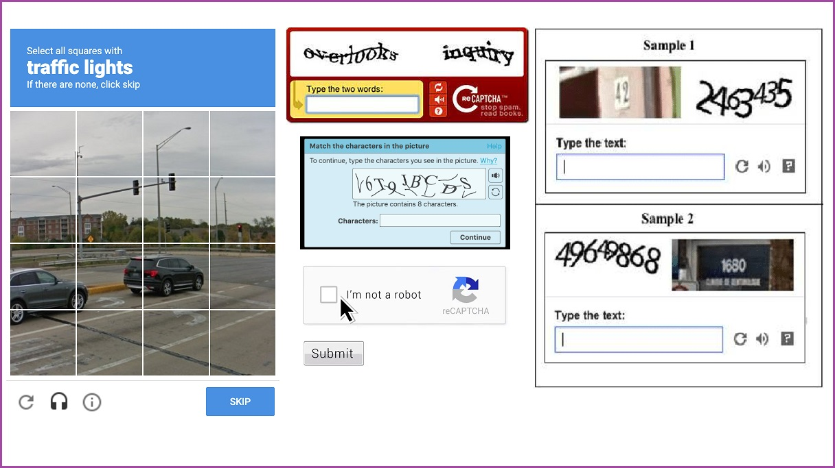
CAPTCHA

Slide 3
Types of CAPTCHA
Text‑based CAPTCHAs
Image‑based CAPTCHAs
Audio‑based CAPTCHAs
Video‑based CAPTCHAs
Cognitive‑based CAPTCHAs

Slide 4
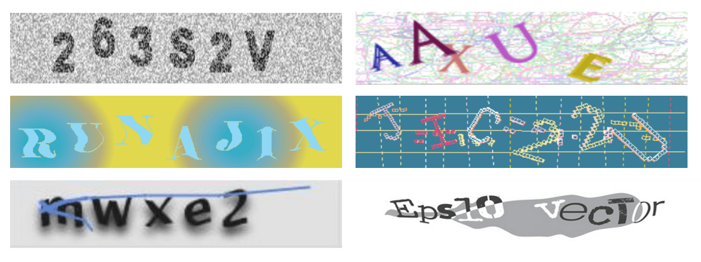
Text‑based CAPTCHAs

Slide 5
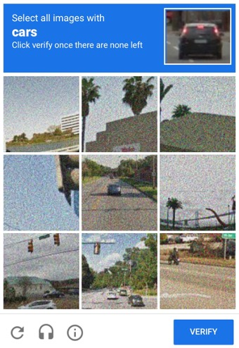
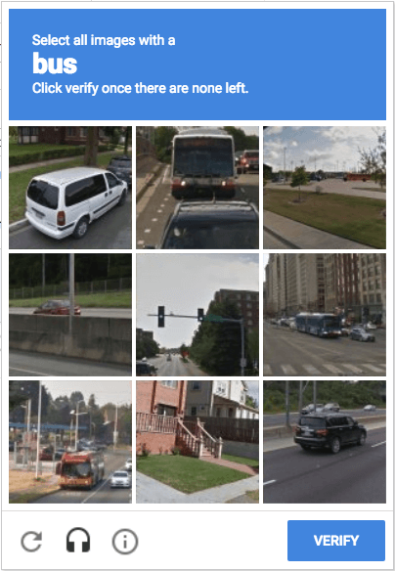
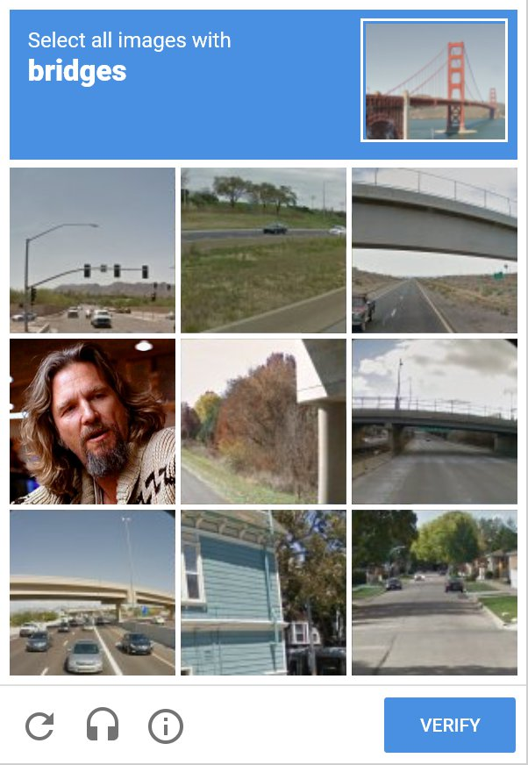
Image‑based CAPTCHAs

Slide 6
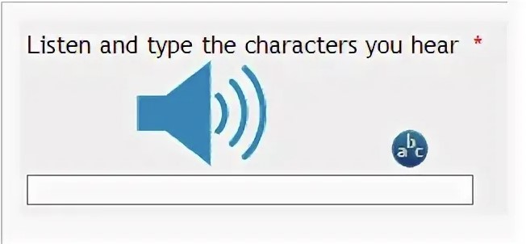
Audio‑based CAPTCHAs

Slide 7
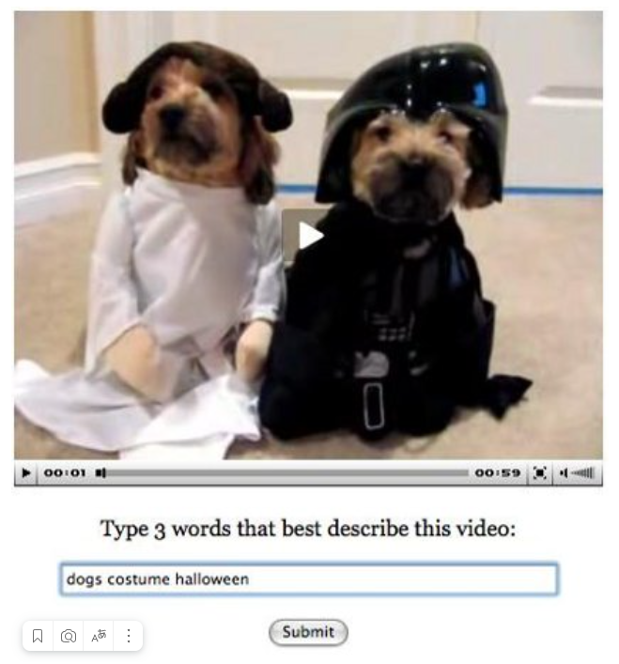
Video‑based CAPTCHAs

Slide 8
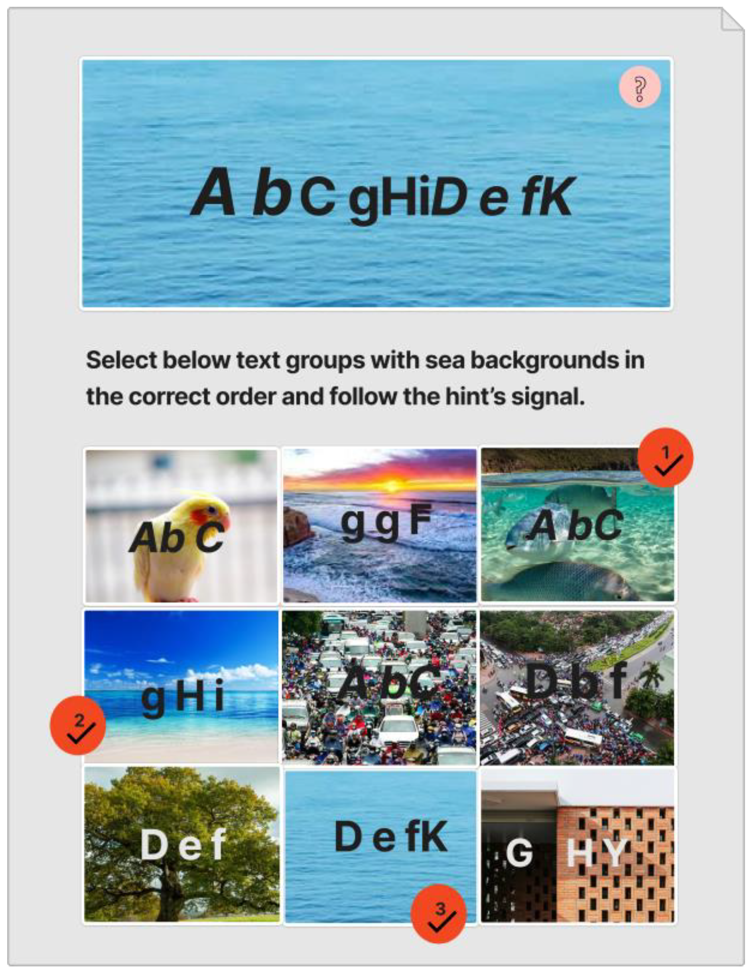
Cognitive‑based CAPTCHAs

Slide 9
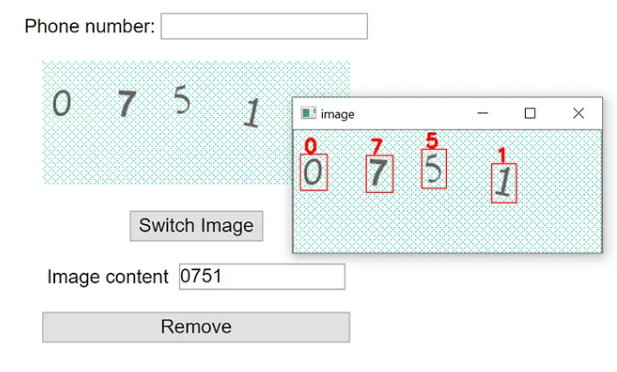
CAPTCHA hacking

Slide 10
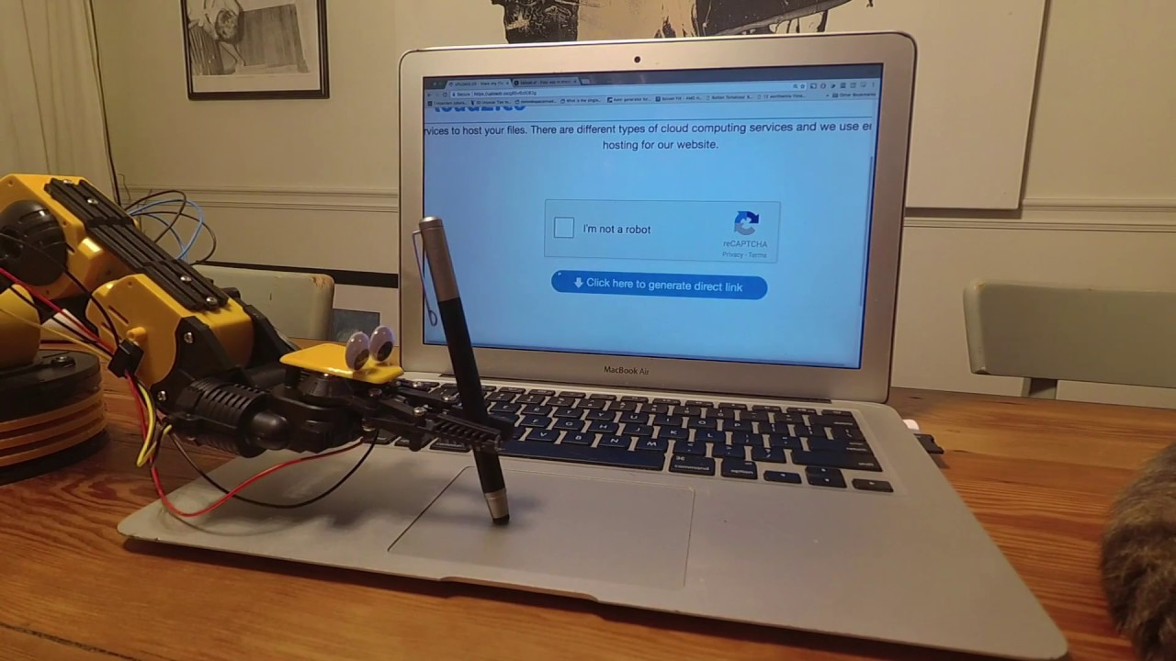
CAPTCHA is a necessity in today's world

